Slide 1

eXtensible Markup Language (XML)
By: Subhadeep Samantaray

Slide 2
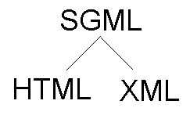
Introduction
A subset of SGML (Standard Generalized Markup Language)
A markup language much like HTML
Stands for Extensible Markup Language
Bridge for data exchange on the Web
Used to structure, store and transport information
Tags are not predefined
Self-descriptive
W3C Recommendation

Slide 3
Advantages
Data stored in plain text format
Easy for humans to read
Hierarchical, and easily processed
Provides a hardware and software independent way of storing data
Different applications can easily share data through XML with low complexity
Makes data more available
Supports internationalization and platform changes

Slide 4
Structure
XML docs form a tree structure
Each document must have a unique first element, the root node
Consists of tags and text
Tags are case sensitive, come in pairs, must be nested properly
A tag may have a set of attributes whose values must be quoted
White space is preserved
XML Docs that conform to above rules are said to be “Well formed”

Slide 5
Structure Continued…
Elements with empty content can be abbreviated
<br/> for <br></br>
<hr width=“10”/> for <hr width=“10”></hr>
XML has only one “basic” type – text
XML text is called PCDATA (parsed character data)
<?xml version="1.0" encoding="UTF-8"?>
<!-- This is a comment -->
<note date="12/11/2007" >
<to> Tove</to>
<from>Jani</from>
<heading>Reminder</heading>
<body>Don't forget me this weekend!</body>
</note>
Example from w3schools.com

Slide 6
Header tag
<?xml version="1.0" standalone="yes/no" encoding="UTF-8"?>
Standalone=“no” means that there is an external DTD
Encoding attribute can be left out and the processor will use the UTF-8 default
From Dr. Praveen Madiraju’s slides

Slide 7
XML is self-descriptive
Nesting of tags can be used to express various structure e.g. a tuple (record)
<person>
<name> Bart Simpson </name>
<tel> 02 – 444 7777 </tel>
<tel> 051 – 011 022 </tel>
<email> bart@tau.ac.il </email>
</person>
From Dr. Praveen Madiraju’s slides

Slide 8
XML doc is a tree
<person>
<name> Bart Simpson </name>
<tel> 02 – 444 7777 </tel>
<tel> 051 – 011 022 </tel>
<email> bart@tau.ac.il </email>
</person>
Leaves are either empty or contain PCDATA
person
name
tel
tel
email
Bart Simpson
051 – 011 022
02 – 444 7777
bart@tau.ac.il
From Dr. Praveen Madiraju’s slides

Slide 9
Address Book as an XML document
A list can be represented by using the same tag repetitively
<addresses>
<person>
<name> Donald Duck</name>
<tel> 414-222-1234 </tel>
<email> donald@yahoo.com </email>
</person>
<person>
<name> Miki Mouse</name>
<tel> 123-456-7890 </tel>
<email>miki@yahoo.com</email>
</person>
</addresses>
From Dr. Praveen Madiraju’s slides

Slide 10
XML Elements vs. Attributes
<person sex="female"> <firstname>Anna</firstname> <lastname>Smith</lastname> </person>
<person> <sex>female</sex> <firstname>Anna</firstname> <lastname>Smith</lastname> </person>
There are no rules about when to use attributes or when to use elements.
Elements are normally preferred over attributes, because:
attributes cannot contain multiple values (elements can)
attributes cannot contain tree structures (elements can)
attributes are not easily expandable (for future changes)
From w3schools.com

Slide 11
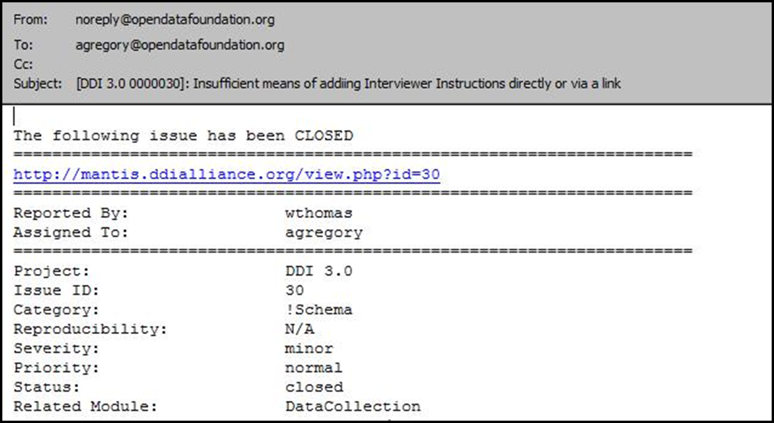
A simple example : Email
From Arofan Gregory’s slides

Slide 12
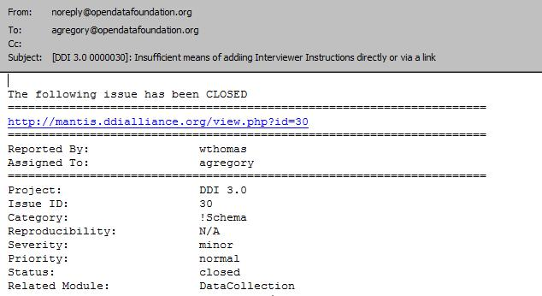
Top-Level Structure
EMail
The entire document must get a single, top-level (“root”) element – in this case,
we will name it “Email”: <Email>[…]</Email>
From Arofan Gregory’s slides

Slide 13
Mid-Level Structure
Header
Body
The e-mail breaks down into two major structural parts: a header and a body
These would be: <Header>…</Header> and <Body>…</Body>
They would always be in the sequence Header, Body
From Arofan Gregory’s slides

Slide 14
Lower-Level Structure
From
To
CC
Subject
There could
also be a
BCC field
The header contains another sequence of elements, each of which contain text:
<From>…</From>, <To>…</To>, <CC>…</CC>,
<BCC>…</BCC>,<Subject>…</Subject>
From Arofan Gregory’s slides

Slide 15
EMail
From Arofan Gregory’s slides
Header
Body
From
To
CC (?)
BCC (?)
Subject
Text
Text
Text
Text
Text
Text
The XML instance can be understood as a structure: a hierarchy of elements and
content. (This is often referred to as a “DOM” and is a common programming structure.)
This structure can be described in a DTD or XML Schema. (?) means that element is optional.

Slide 16
Resulting XML Instance
<?xml version="1.0" encoding="UTF-8"?>
<Email>
<Header>
<From>agregory@odaf.org</From>
<To>jdakes@yahoo.com</To>
<CC>cgregory@earthlink.net</CC>
<Subject>News from Dagstuhl</Subject>
</Header>
<Body>
Dagstuhl is amazing, but they seem to be overrun by owls. I hope you guys are doing well, and that Calum isn’t watching too much TV.
</Body>
</Email>
From Arofan Gregory’s slides

Slide 17
Namespaces
Provide a method to avoid element name conflicts
Name conflict often occurs when trying to mix XML docs from different XML applications
XML carrying HTML table information
<table> <tr> <td>Apples</td> <td>Bananas</td> </tr> </table>
XML carrying information about a table (a piece of furniture)
<table> <name>
African Coffee Table
</name> <width>80</width> <length>120</length> </table>
From w3schools.com

Slide 18
Namespaces Cont’d…
Name conflicts can easily be avoided using a name prefix
A “namespace” for the prefix must be defined
Namespace declaration has the syntax- xmlns:prefix="URI“
All child elements with the same prefix are associated with the same namespace
Namespace URI is not used by the parser to look up information
Companies often use the namespace as a pointer to a web page containing namespace information

Slide 19
Namespaces Cont’d…
<root>
<h:table xmlns:h="http://www.w3.org/TR/html4/"> <h:tr> <h:td>Apples</h:td> <h:td>Bananas</h:td> </h:tr> </h:table> <f:table xmlns:f="http://www.w3schools.com/furniture"> <f:name>African Coffee Table</f:name> <f:width>80</f:width> <f:length>120</f:length> </f:table>
</root>
From w3schools.com

Slide 20
Document Type Definitions (DTD)
An XML document may have an optional DTD
DTD serves as grammar for the underlying XML document, and it is part of XML language
DTD has the form:
<!DOCTYPE name [markupdeclaration]>
XML document conforming to its DTD is said to be valid
From slides by Ayzer Mungan et. al.

Slide 21
DTD Example
<db><person><name>Alan</name>
<age>42</age>
<email>agb@usa.net </email>
</person>
<person>………</person>
……….
</db>
DTD for it might be:
<!DOCTYPE db [
<!ELEMENT db (person*)>
<!ELEMENT person (name, age, email)>
<!ELEMENT name (#PCDATA)>
<!ELEMENT age (#PCDATA)>
<!ELEMENT email (#PCDATA)>
]>
From slides by Ayzer Mungan et. al.

Slide 22
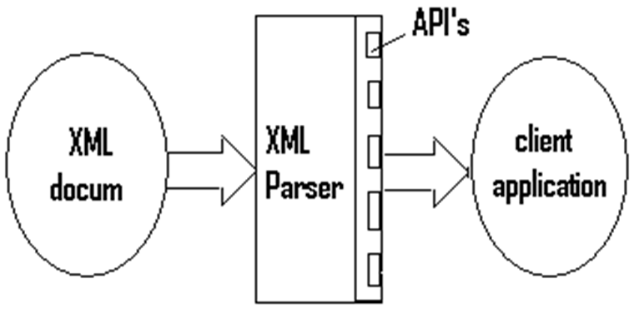
XML Parser
Software library (or a package) that provides methods (or interfaces) for client applications to work with XML documents
Shields client from the complexities of XML manipulation
May also validate the document
From slides by Chongbing Liu

Slide 23
XML Parsing Standards
We will consider two parsing methods that implement W3C standards for accessing XML
SAX (Simple API for XML)
Event-driven parsing
“Serial access” protocol
Read only API
DOM (Document Object Model)
Converts XML into a tree of objects
“Random access” protocol
Can update XML document (insert/delete nodes)
From slides by Rajshekhar Sunderraman

Slide 24
SAX Parser
Scans an xml stream on the fly
Very different than digesting an entire XML document into memory.
When the parser encounters start-tag, end-tag, etc., it thinks of them as events
When such an event occurs, the handler automatically calls back to a particular method overridden by the client, and feeds as arguments the method what it sees
Purely event-based, it works like an event handler in Java (e.g. MouseAdapter)

Slide 25
Obtaining SAX Parser
//Important classes
javax.xml.parsers.SAXParserFactory;
javax.xml.parsers.SAXParser;
javax.xml.parsers.ParserConfigurationException;
//get the parser
SAXParserFactory factory = SAXParserFactory.newInstance();
SAXParser saxParser = factory.newSAXParser();
//parse the document
saxParser.parse( new File(argv[0]), handler);

Slide 26
SAX Event Handler
Must implement the interface org.xml.sax.ContentHandler
Easier to extend the adapter org.xml.sax.helpers.DefaultHandler
Most important methods to override
void startDocument()
void endDocument()
void startElement(...)
void endElement(...)
void characters(...)

Slide 27
SAX Parser Cont’d…
Advantages
Simple and Fast
Memory efficient
Works well in stream application
Disadvantages
Data is broken into pieces
Clients never have all the information as a whole unless they create their own data structure
Need to reparse if you need to revisit data
From slides by Chongbing Liu

Slide 28
DOM Parser
Creates a tree object out of the document
User accesses data by traversing the tree
The API allows for constructing, accessing and manipulating the structure and content of XML documents
API
Application
XML File
DOM Parser
DOM Tree
From slides by Rajshekhar Sunderraman

Slide 29
DOM Parser
Create a DOM tree directly in memory
DocumentBuilderFactory factory = DocumentBuilderFactory.newInstance();
DocumentBuilder builder = factory.newDocumentBuilder();
document = builder.newDocument();
Element root = doc.getDocumentElement();
Once the root node is obtained, typical tree methods exist to manipulate other elements
boolean node.hasChildNodes()
NodeList node.getChildNodes()
Node node.getNextSibling()
Node node.getParentNode()
String node.getValue();
String node.getName();
String node.getText();
void setNodeValue(String nodeValue);
Node insertBefore(Node new, Node ref);

Slide 30
DOM Parser Cont’d…
Advantages
Random access possible
Easy to use
Can manipulate the XML document
Disadvantages
DOM object requires more memory storage than the XML file itself
A lot of time is spent on construction before use
May be impractical for very large documents
From slides by Rajshekhar Sunderraman

Slide 31
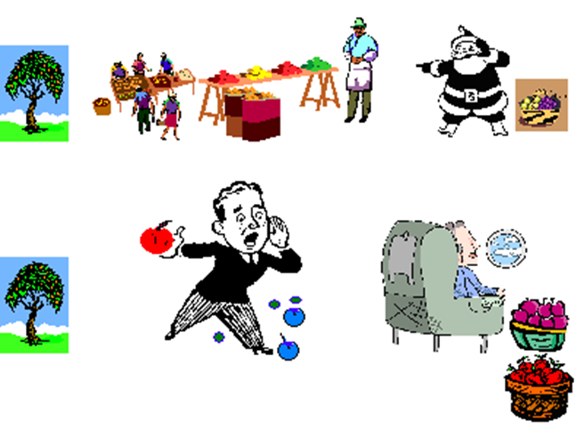
DOM and SAX Parsers
From slides by Chongbing Liu

Slide 32
Thank You

